Slide 1
Vehicle Simulator
Cody Adams
Matthew June

Slide 2
Scope statement
The system will consist of the software and a mechanical device that the driver will sit in. The mechanical device will contain the interface that the driver will use to control the ambulance and a viewing screen. The device will need to be able to realistically mimic the movements of an ambulance under various road conditions and in different situations. In order to do this the software will need to be able to perform large amounts of physics calculations. The system would sync up with a database that would keep track of the statistics of the driver and his performance that could be analyzed later and could show improvements over a period of time. The user interface of the machine could be basically a stripped ambulance. Parts of the ambulance that need to be manipulated (such as the wheel, gas, brake and clutch pedals, shifter, wipers/lights etc) would now be set up as input devices ready to read the users actions and send the information to be handled by a main physics engine. These same input devices would also need to be output devices to a degree, where pedals would need to lock up and resist in certain conditions, and the wheel would pull toward centering the tires when the ambulance was accelerating. A visual display replacing the mirrors and windows in the car would be output only devices, and the same signal sent to them could also be sent to a monitor outside the simulator so a third party, such as the instructor, could monitor the simulation.

Slide 3
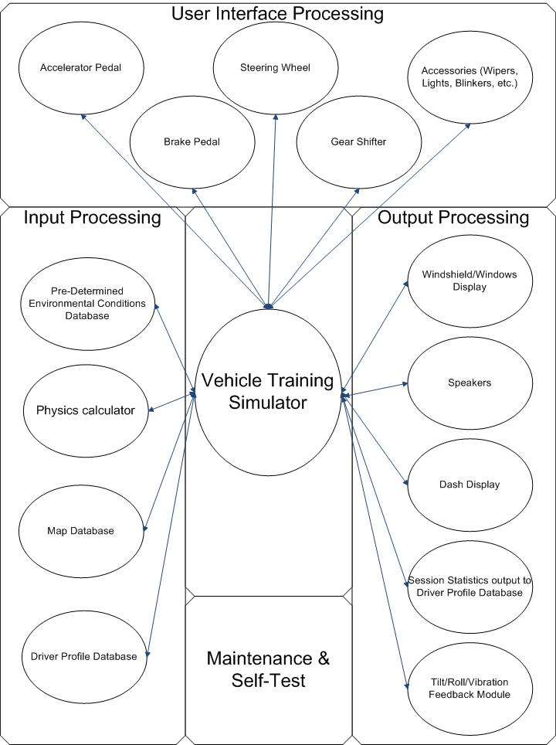
Hatley pirbhai

Slide 4
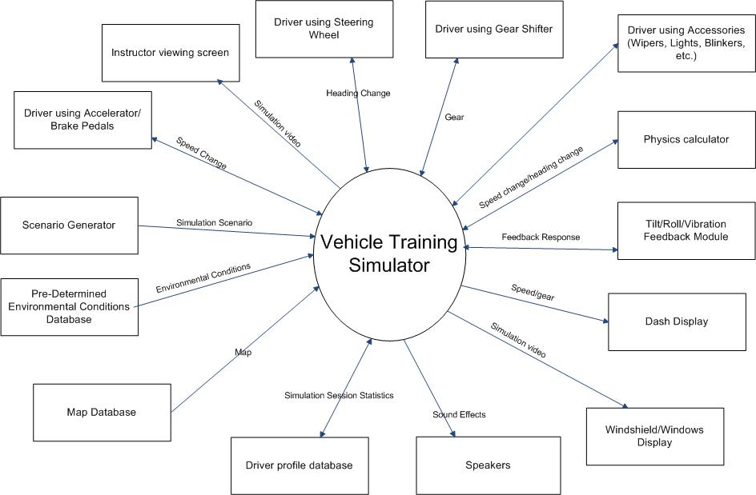
Context diagram

Slide 5
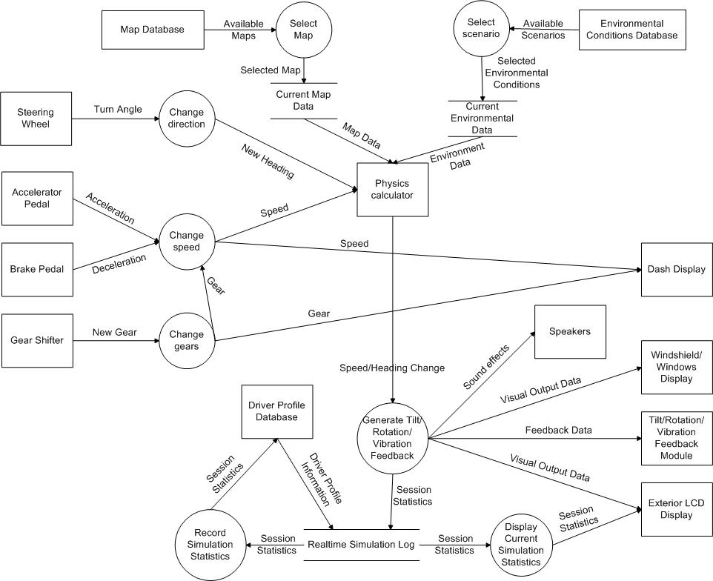
Top level Dfd

Slide 6
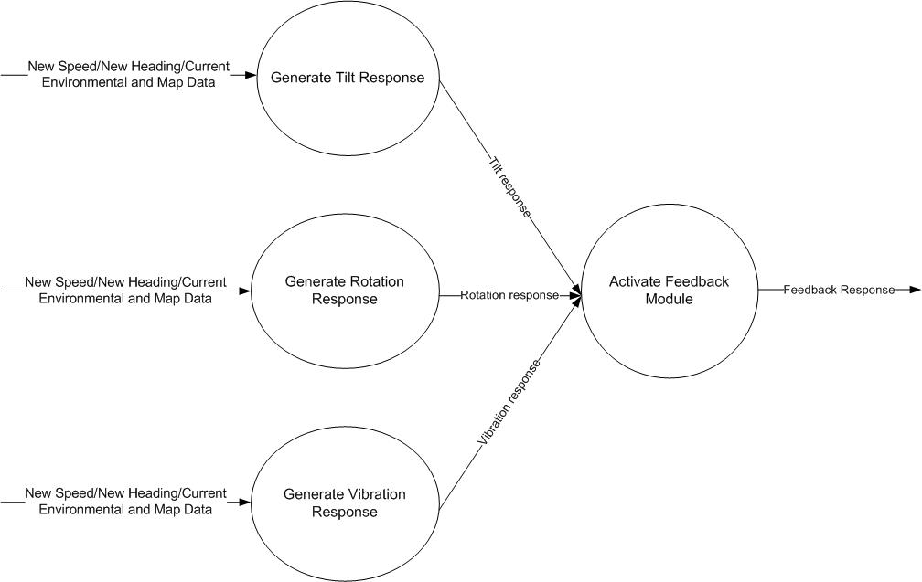
Feedback generation 2nd level dfd

Slide 7
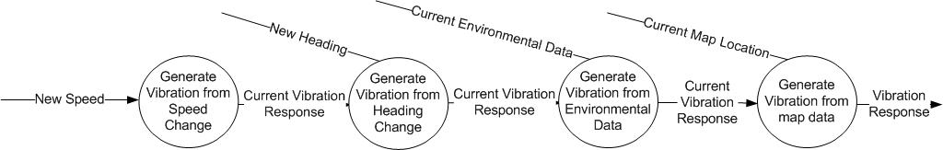
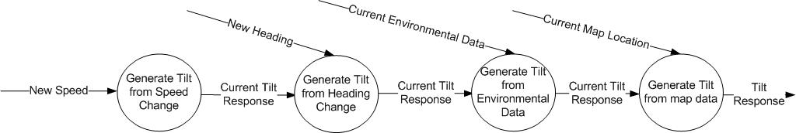
Vibration and tilt 3rd level dfds

Slide 8
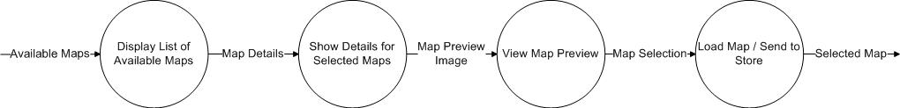
Map selection 2nd level dfd

Slide 9
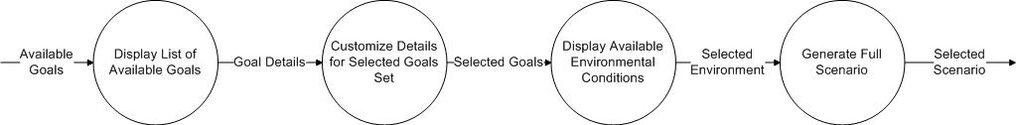
Scenario selection 2nd level dfd

Slide 10
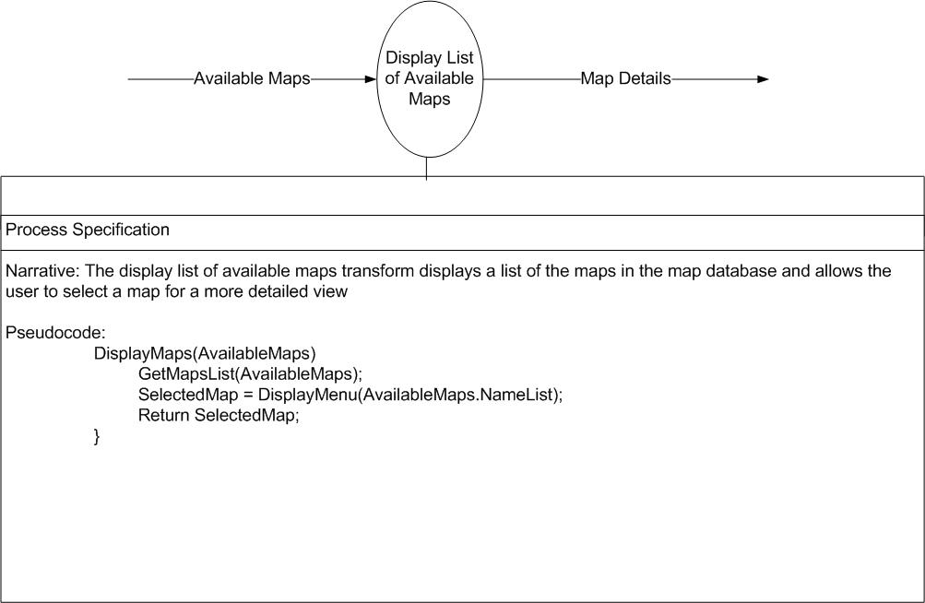
Display available maps PSPEC

Slide 11
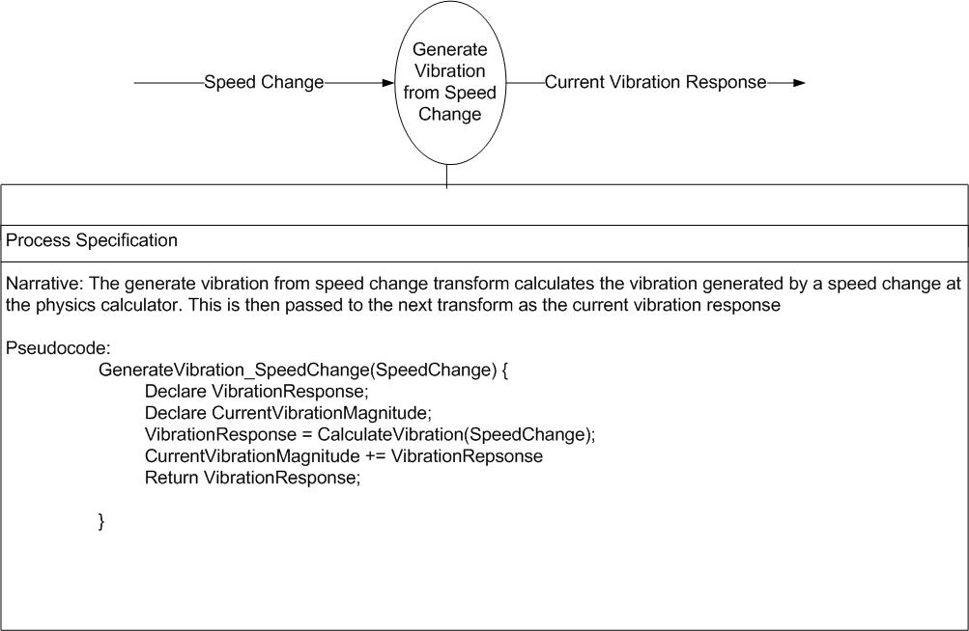
Vibration from speed change PSPEC

Slide 12
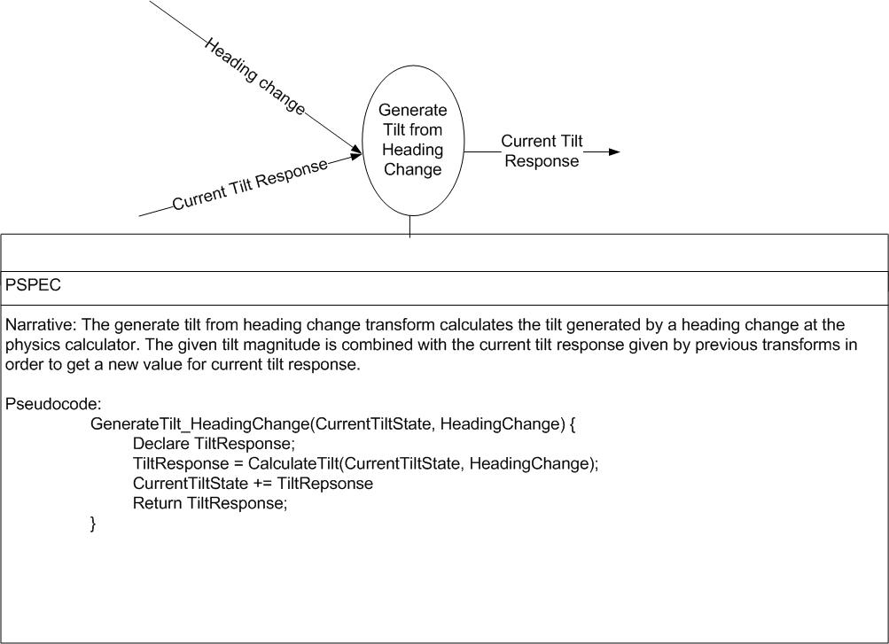
Tilt from heading change PSPEC

Slide 13
Class list
Actor Classes:
Driver
Instructor
Business Classes:
Physics calculator
Feedback module
Driver profile database
Environmental conditions database
Map database
Interface Classes:
Driver viewing screen
Instructor viewing screen
Instructor setup screen
Dash display
Shifter
Steering wheel
Accelerator
Brakes

Slide 14
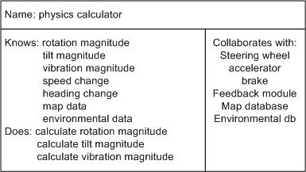
Physics calculator class

Slide 15
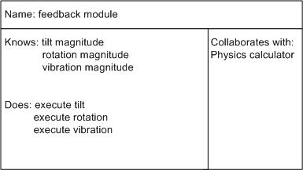
Feedback module class

Slide 16
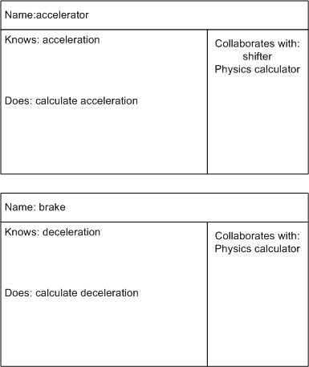
Accelerator and Brake classes

Slide 17
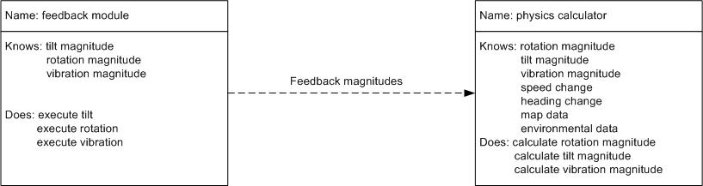
Class Dependency

Slide 18
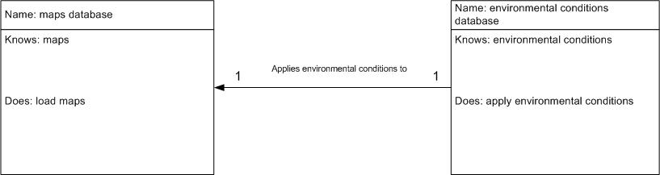
Class Association

Slide 19
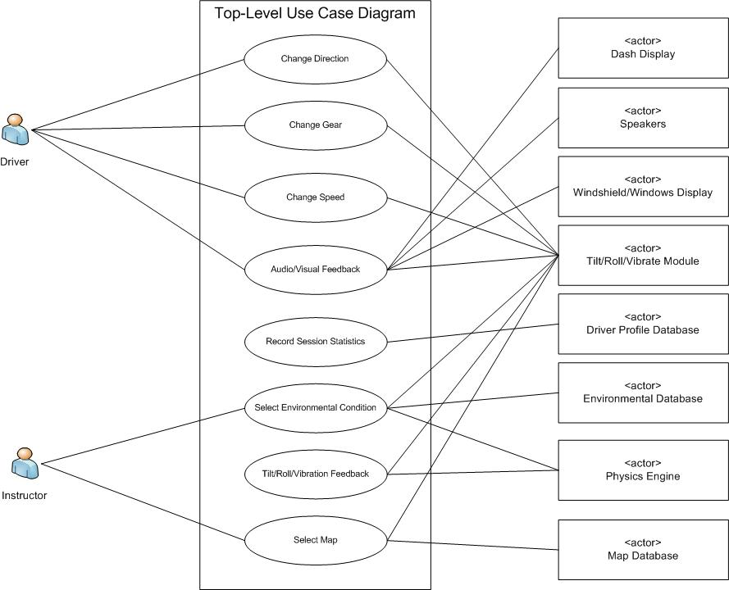
Use case diagram

Slide 20
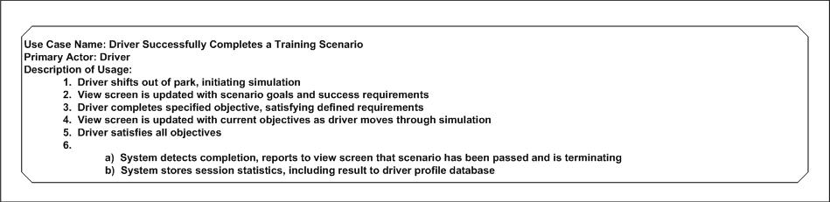
Successful completion use case

Slide 21
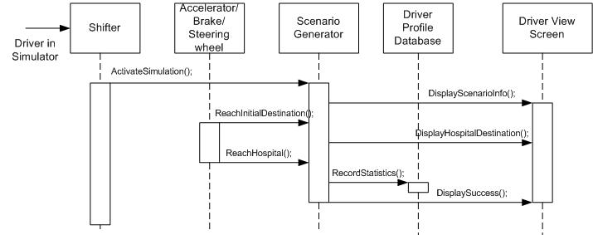
Successful completion sequence chart

Slide 22
Simulation setup use case

Slide 23
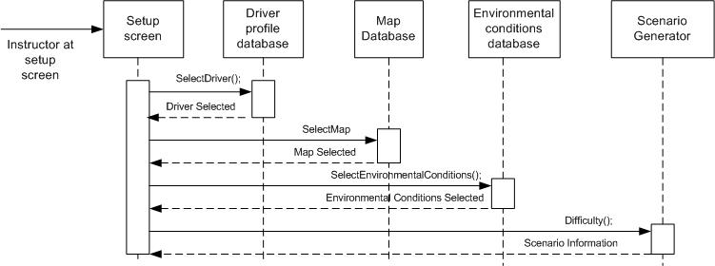
Simulation setup sequence chart

Slide 24
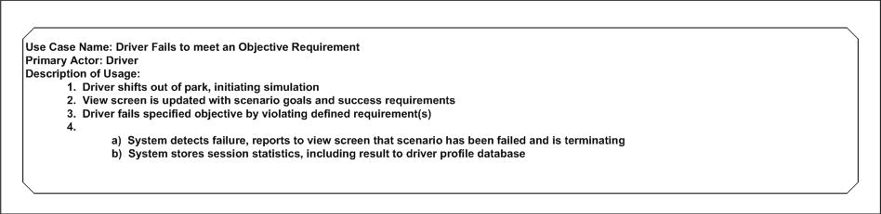
Fail simulation use case

Slide 25
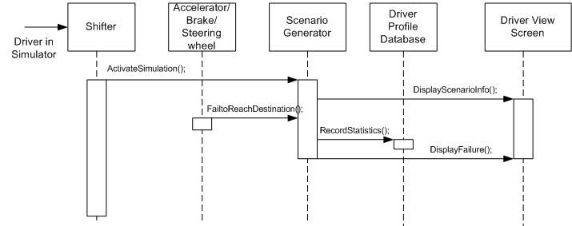
Fail simulation sequence chart

